Slide 1

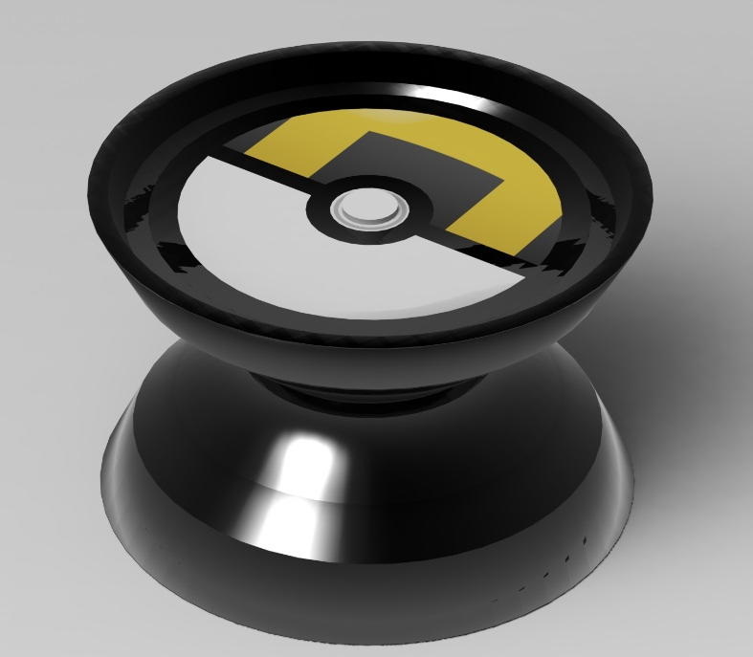
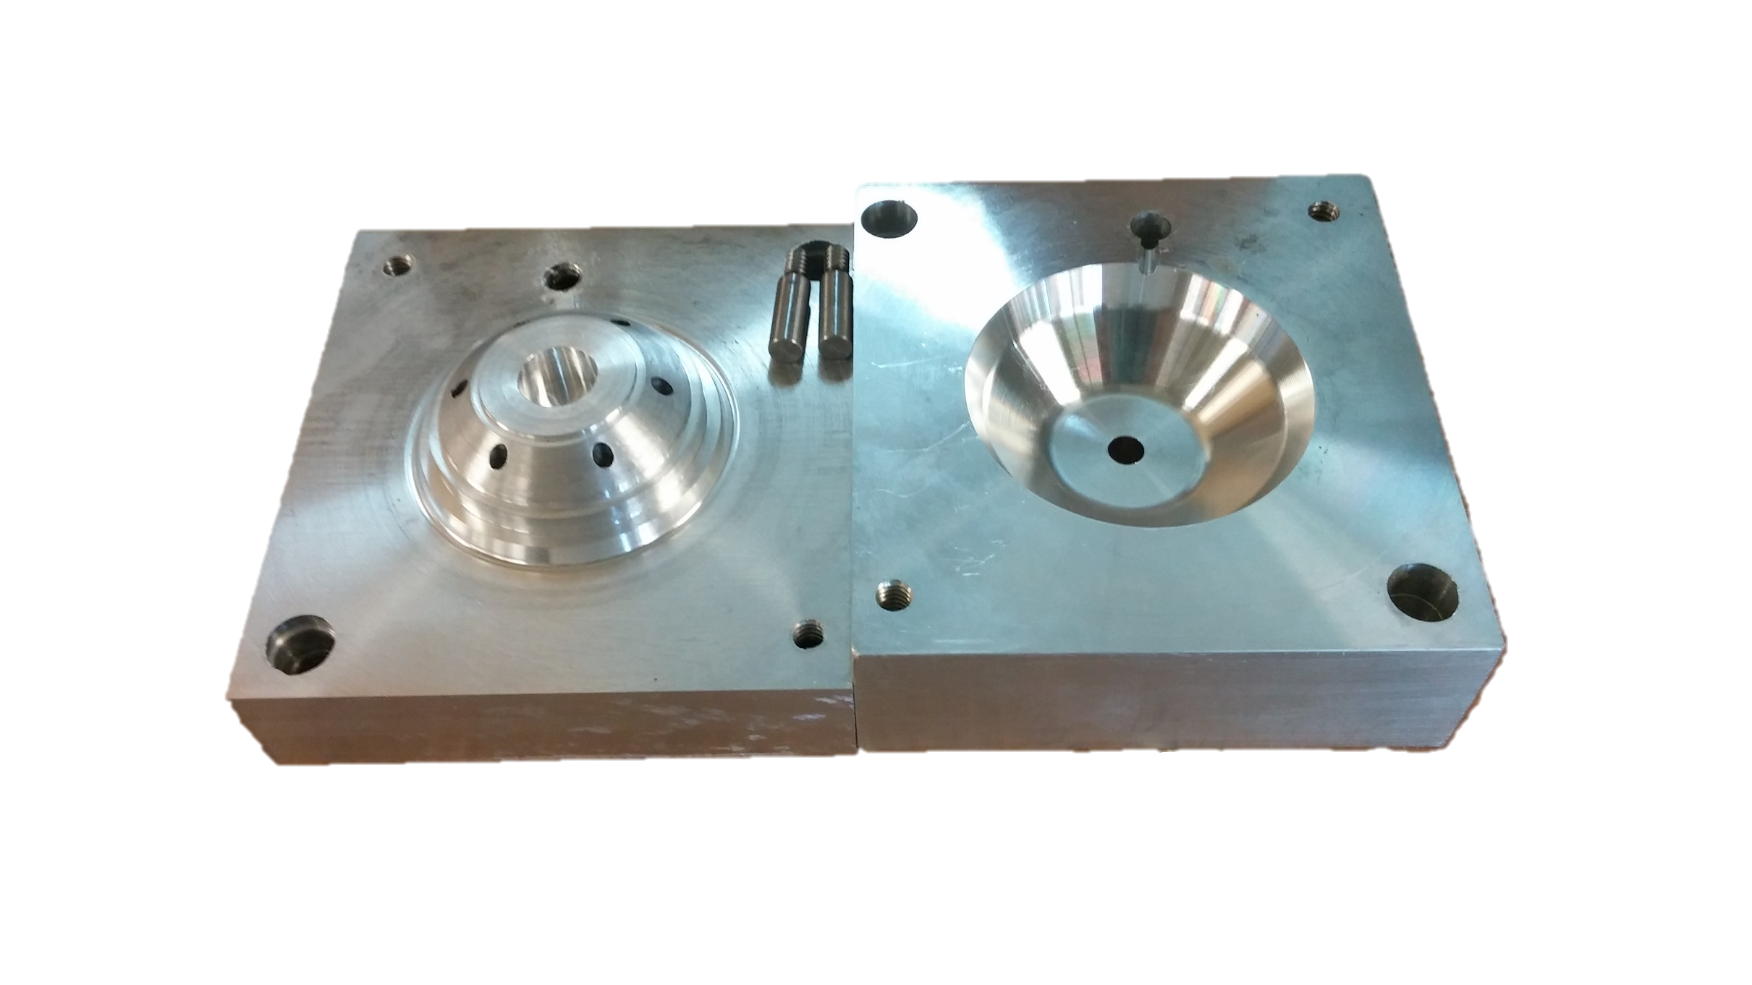
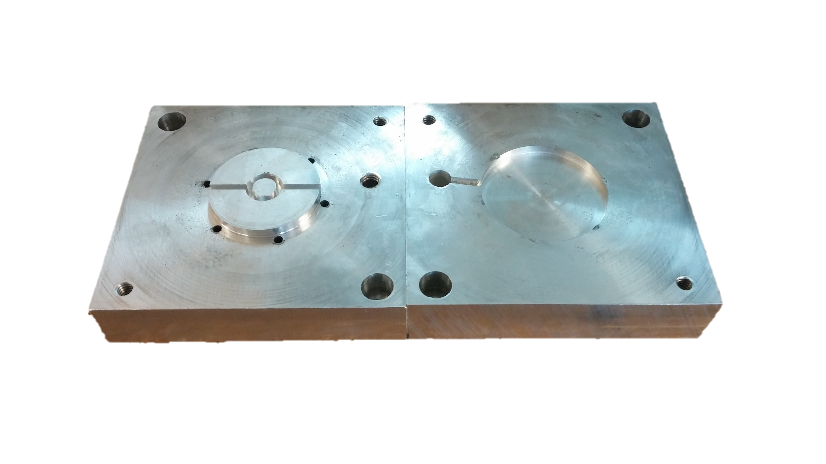
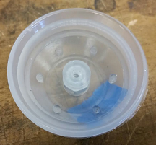
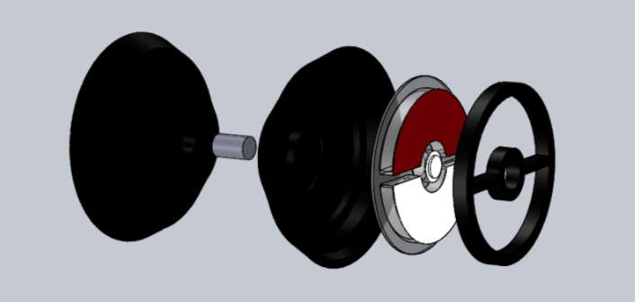
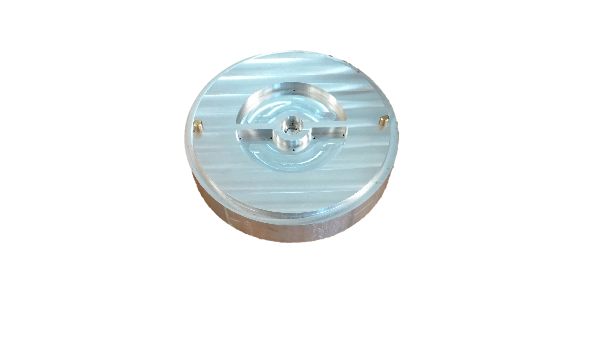
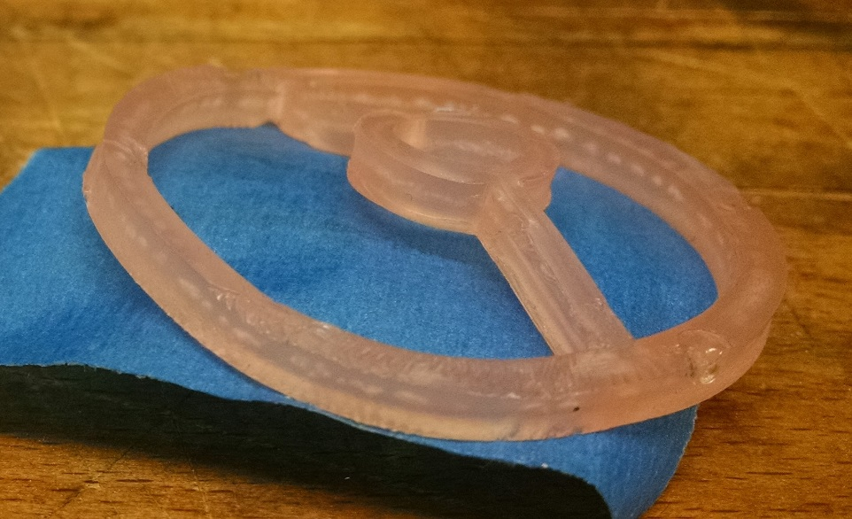
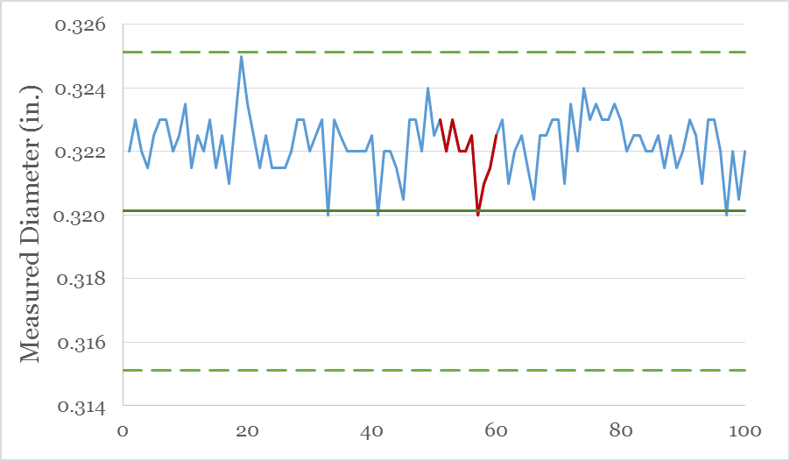
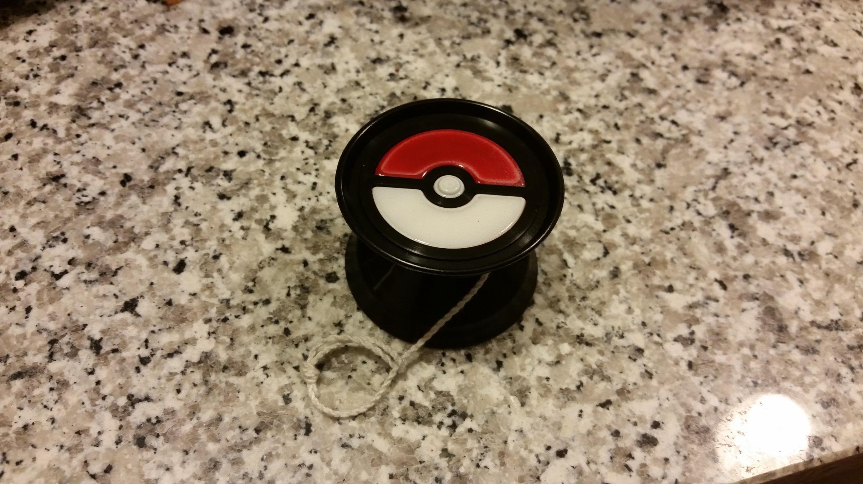
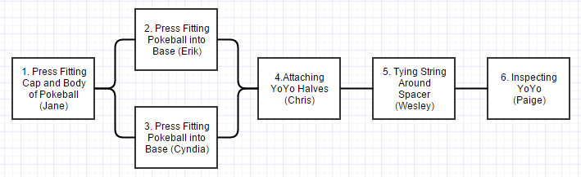
Spinny Things
Cyndia Cao, Jane Coffrin, Wesley Cox, Erik Gest, Chris Kwok, Paige Reiter
mitspinnythings.blogspot.com | spinnythings@mit.edu
2.008 FALL 2015
Introduction
Tooling Design
Process Optimization
Base Mold
Injection Molded Base
Initially had flash, only on one side
Added shim to IM machine to align the molds
Reduced shot size from 25 to 19mm
Reduced cooling time, experienced excessive shrinkage
Settled on 25 second cooling time
We decided to create a Poké Ball yo-yo. We agreed on making both regular red and white Poké Balls (below) as well as a few Hyper or Ultra Balls (above). We ultimately decided on a butterfly-shaped yo-yo over a spherical shape because the butterfly shape is comparable to those used my professional yo-yoers.
Complete freedom with ejector pin placement because they were hidden
Top surface was filleted to remove sharp parting line edge
Cap Mold
Prototype base part showing one sided flash
Easy to make drastic changes quickly due to simple, mostly circular features
Interface to both base & thermoform means all interference problems can be fixed from only changing the cap
Injection Molded Cap
Biggest challenge was ejection
Draft added to mold to help
Mold release also used
Next, cooling times optimized
20 seconds chosen for the cooling time because it allowed 8 parts to successfully eject between sprays
Specifications
Thermoform Mold
Part | Dimension | Predicted Value (in) | Measured Value (in)
Base | Cap interface | 1.785 ± 0.005 | 1.795 ± 0.008
Cap | Outer diameter (base interface) | 1.795 ± 0.005 | 1.792 ± 0.006
Thermo-form | Button diameter | 0.320 ± 0.005 | 0.322 ± 0.003
Used a pocket because outer diameter sizes are most important for interface
Production Results
Cost Analysis
The Final Product
Part | Cp | Cpk
Thermoform | 1.8398 | 1.0616
Cap | 0.8133 | 0.4535
Base | 0.6433 | -0.6228
This lightweight yo-yo is built for speed. Its concave halves, shaped like typical professional yo-yos, make this product well-balanced and easy to control. Intended for ages 5 and up, this Poké Ball yo-yo is a nostalgic nod to one of
the most popular gaming franchises of all time and is sure to delight both children, teenagers, and parents alike.
Assembly Process
Lessons Learned
Shrinkage is a considerable concern and should be accounted for
Deburring and draft are critical to insure part ejection
Careful design reduces the need for remachining and saves time overall
Consideration of proper Design for Manufacturing techniques improves both part and assembly quality
Press fitting components allowed for easy assembly
Doubling up on items 2 and 3 prevented process from bottlenecking
Line was organized to create buffers so no person was idle

